Slide 1

“Digital Logic Design”
Lecture # 13

Slide 2
Karnaugh Map

Slide 3



The Karnaugh map, also known as the K-map, is a method to simplify boolean algebra expressions.
The Karnaugh map reduces the need for extensive calculations by taking advantage of humans' pattern-recognition capability.
The required boolean results are transferred from a truth table onto a two- dimensional grid where the cells are ordered in Gray code, and each cell position represents one combination of input conditions, while each cell value represents the corresponding output value. Optimal groups of 1s or 0s are identified.
These terms can be used to write a minimal boolean expression representing the required logic.

Slide 4
Karnaugh Maps - Rules of Simplification

Slide 5

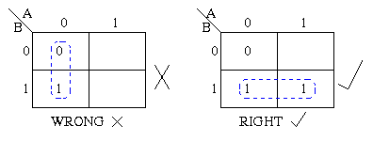
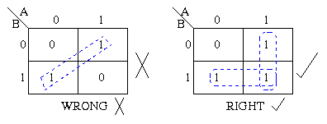
The Karnaugh map uses the following rules for the simplification of expressions by grouping together adjacent cells containing ones.
1.Groups may not include any cell containing a zero.
2.Groups may be horizontal or vertical, but not diagonal.

Slide 6
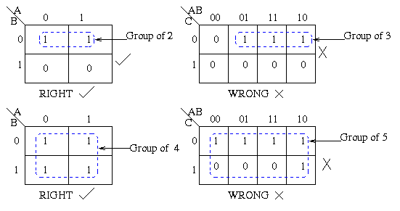
3. Groups must contain 1, 2, 4, 8, or in general 2^{n} cells. That is if n = 1, a group will contain two 1's since 2¹ = 2. If n = 2, a group will contain four 1's since 2² = 4.

Slide 7
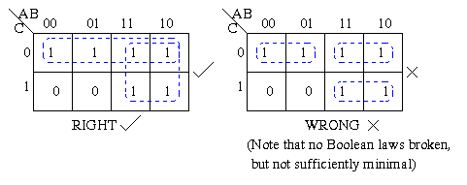
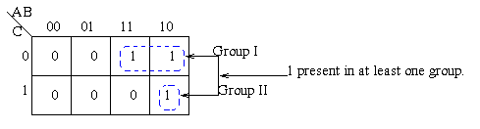
4. Each group should be as large as possible.
5.Each cell containing a one must be in at least one group.

Slide 8
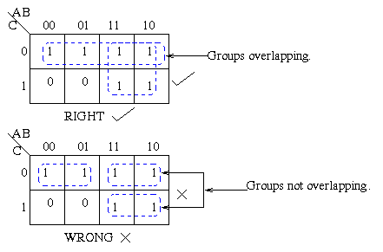
6.Groups may overlap.

Slide 9
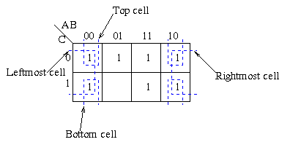
7.Groups may wrap around the table.
The leftmost cell in a row may be grouped with the rightmost cell and the top cell in a column may be grouped with the bottom cell.

Slide 10
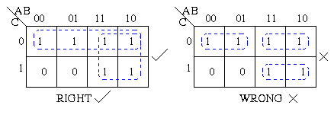
8. There should be as few groups as possible, as long as
this does not contradict any of the previous rules.

Slide 11
Summmary:
No zeros allowed.
No diagonals.
Only power of 2 number of cells in each group.
Groups should be as large as possible.
Every one must be in at least one group.
Overlapping allowed.
Wrap around allowed.
Fewest number of groups possible.

